Slide 1
Classification and Text Analysis of Public Comments to Regulations

Slide 2
Problem and End Users of Output
Classification of Comments for SMEs
Problem: +1,000 pages of comments in mostly PDF form that need to be sorted for SMEs
Current Solution: A handful of unlucky work over the weekend to convert, read and sort the documents
New Solution: Use data science to convert and sort documents
Text Analysis for Leadership
Problem: Leadership wants a breakdown of the comments quickly
Current Solution: Pay contractor to do the analysis with varying levels of success and speed
New Solution: Use data science to cluster commenters to create estimates of who is commenting on what

Slide 3
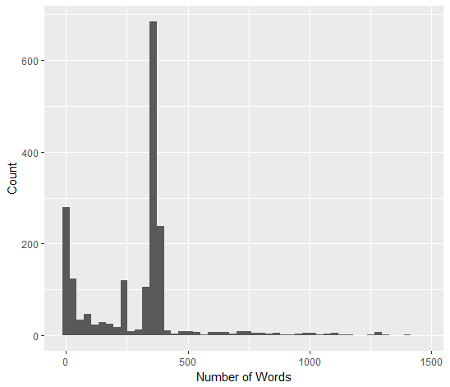
The Dataset
Text
Comments range from short couple of sentences from private citizens to 50-page analyses from industry leaders
<Distribution of word count>
Metadata (Varying Levels of Completeness)
Name
Address
Organization
Email

Slide 4
Methods
PDF to Text Conversion
Using VBA to automate conversion of PDFs to word using Adobe’s OCR and automate extraction of text into Excel
Comment Classification
Use regulation text to create topic model
Use SME’s expert knowledge to enhance the model by adding keywords not used or identified in regulation text
Grouping Comments by Industry and Provision
Manual rules (ex. <10 words & popular email provider = private citizen)
Topic Modeling
Identify Important Comments
Use metadata
Sentiment Analysis

Slide 5
Challenges – Balancing Automation vs Individual Analysis
Goal of Project: Create a process for sorting and analyzing comments
Problem: The context of each regulation response is different
Not every provision may have enough or good words for classification
Commenters may use very different words when describing something
Write-in campaigns creating unbalanced datasets
General Solution: Create baseline process for handling the good and reports to identify the potential issues

Slide 6
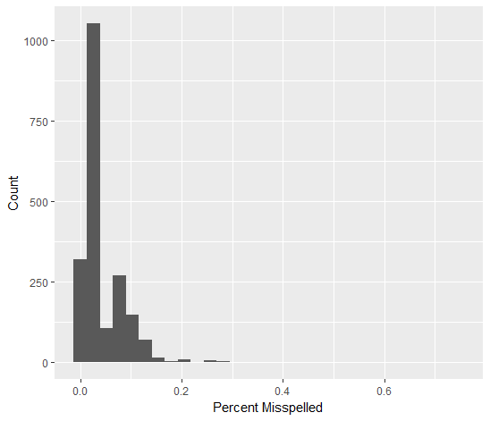
Challenges - Accuracy of OCR
Document ID | Total Words | Misspelled Words | Percent Misspelled
CMS-2017-0156-1606-4 | 39 | 29 | 74%
CMS-2017-0156-1391-1 | 985 | 726 | 74%
CMS-2017-0156-1606-3 | 303 | 179 | 59%
CMS-2017-0156-1606-1 | 78 | 45 | 58%
CMS-2017-0156-1546-0 | 2 | 1 | 50%
CMS-2017-0156-1191-1 | 19 | 7 | 37%
CMS-2017-0156-1661-1 | 269 | 79 | 29%
CMS-2017-0156-1606-2 | 197 | 57 | 29%
CMS-2017-0156-1517-0 | 7 | 2 | 29%
CMS-2017-0156-1665-1 | 1166 | 299 | 26%

